Slide 1

Columbia Engineering Data Analytics Bootcamp
Final PROJECT
Fernando v. santos filho

Slide 2
Creating Alternative Stock Indexes Using Unsupervised ML
- Author: Fernando Vieira Santos Filho
- Prepared for Columbia Engineering Data Analytics Bootcamp – June 2021
- Software: Python
- Data: Bloomberg – Brazil Stock Markets

Slide 3
Creating Alternative Stock Indexes Using Unsupervised ML
Problem Definition
Solution Proposal
Preparing Data
Calculating Returns
Preparing Data for PCA Calculation
PCA Transformation
PC1 Composition
Testing the New Index
Beta Analysis
Conclusion
PC2 Composition
PC3 Composition
Power of Uncorrelation

Slide 4
Problem Definition
Current indexes methodology are driven by economic representation of the stock market, since they weight the size of each company (market capitalization)
This methodology makes the index very dependable on very large companies and don’t provide enough risk diversification, especially in emerging countries like Brazil, where the concentration on big names gets even stronger (therefore we are using this country it in this project)
Investors don’t really care about market capitalization; they are more concerned in having a better return for their risk (better Sharpe Ratio)
Classic style factors indexes are assumed to have low correlation within themselves, but this assumption is not necessarily true.

Slide 5
Solution Proposal
Using Unsupervised Machine Learning (PCA) to find common factors across different stocks within a data series to build an alternative index that represents sensitivity of the overall stock market without taking in consideration market capitalization.
Validate that this index is a good representation of the market.
Generate other principal components that can be used as a style factors, but with no correlation within themselves.

Slide 6
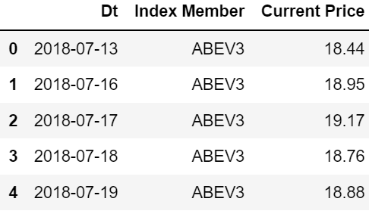
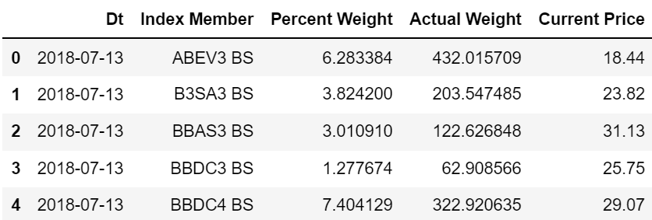
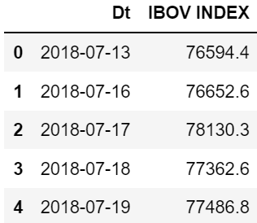
Preparing Data
Retrieve from Bloomberg data for daily stock prices, actual stock index (Ibov), and actual Ibov weights
Stock Prices
Actual Weights
Ibov Prices

Slide 7
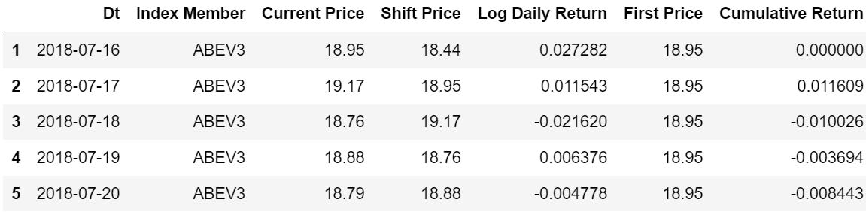
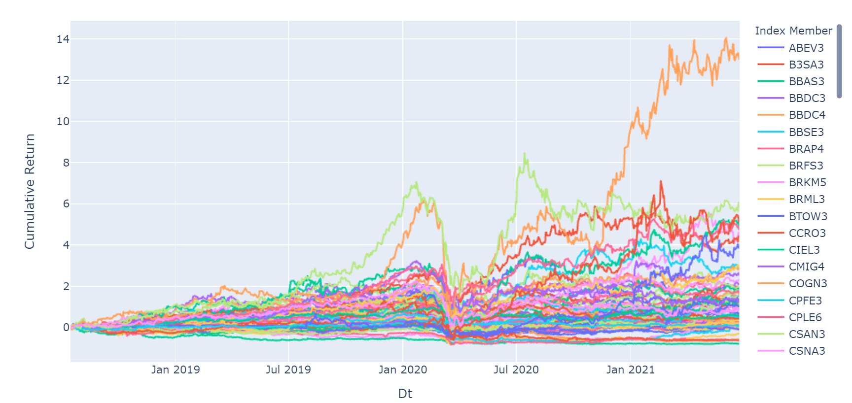
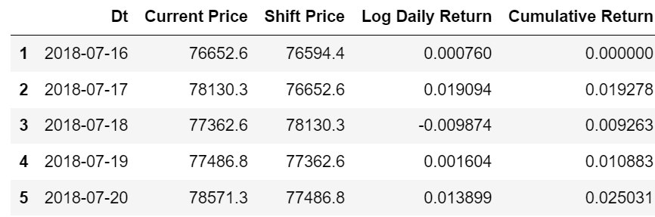
Calculating Returns
Stocks
Calculate log returns for all stocks for the last 3 years.
As we can observe, data is not uniform, and therefore we need to find common components within themselves.
Ibov

Slide 8
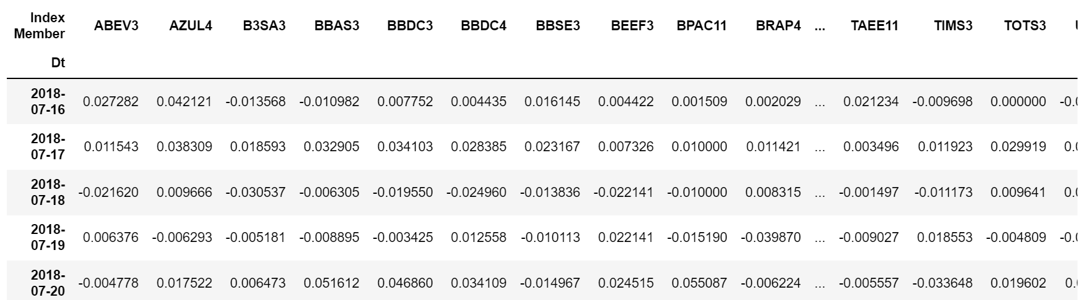
Preparing Data for PCA Calculation
We generate a pivot table providing returns per stock for every single day

Slide 9
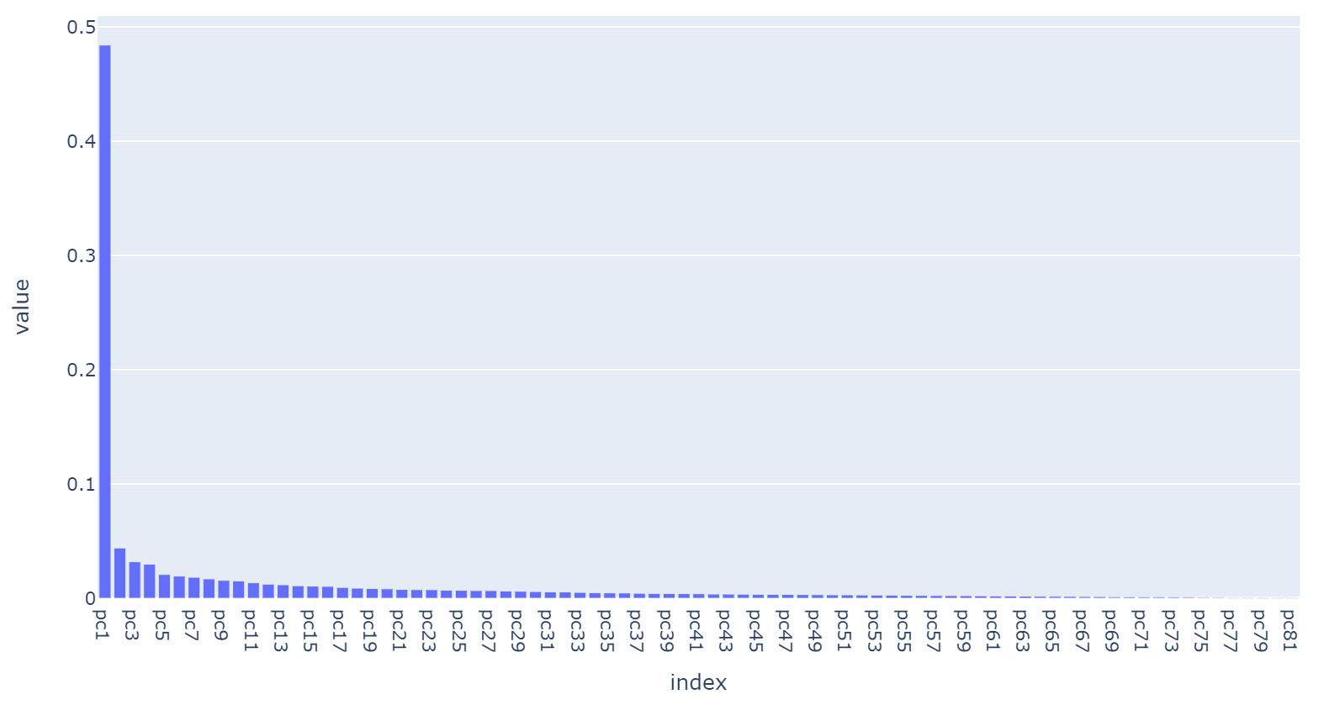
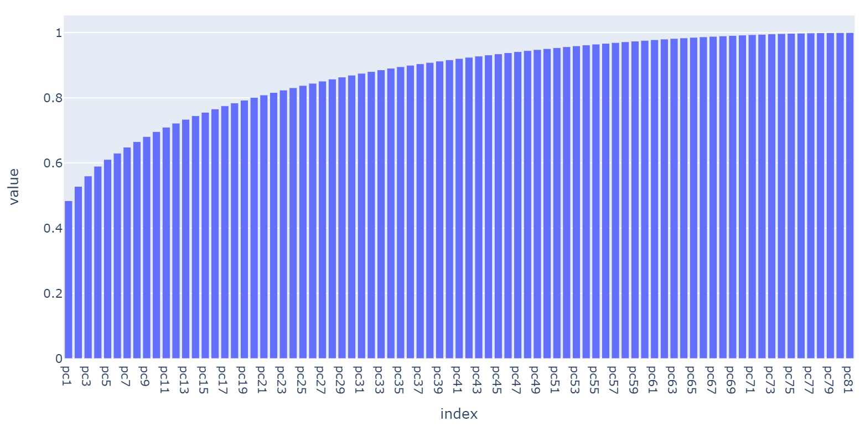
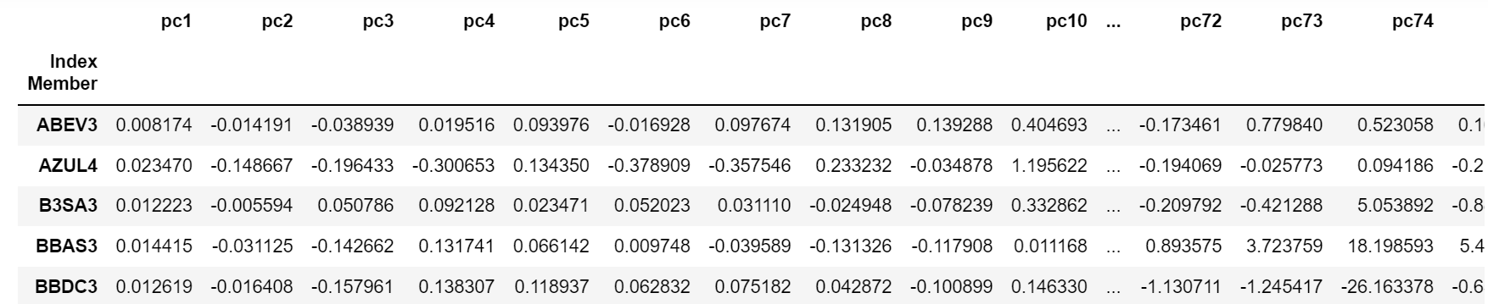
PCA Transformation
Then we run a PCA on the stock returns. Please note that PC1 explains almost 50% of the stock returns. It is easy to imply that the first principal component is a parallel shift of all stocks, where every single stock has its unique contribution given by its loading. So, this is what is going to be used to build the new stock index, and what we will try to validate.

Slide 10
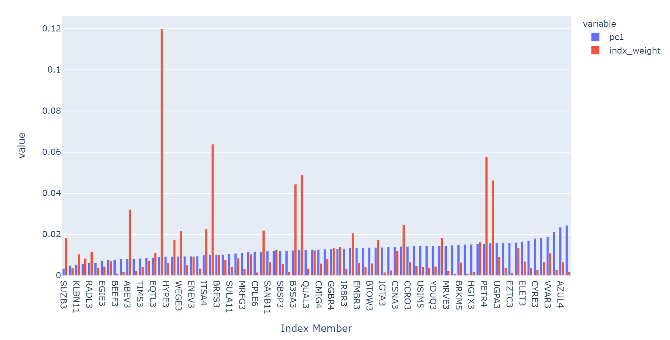
PC1 Composition
In this chart, we can compare Ibov actual composition in red, and the composition of the index built with PC1 loadings in blue. It is easy to observe that while in the original composition there’s high concentration of weight in few names (with one name being responsible for 12% of the index), in the PC1 we have a much smoother composition, what provides a much better diversification with no idiosyncratic risk concentrated in few names.

Slide 11
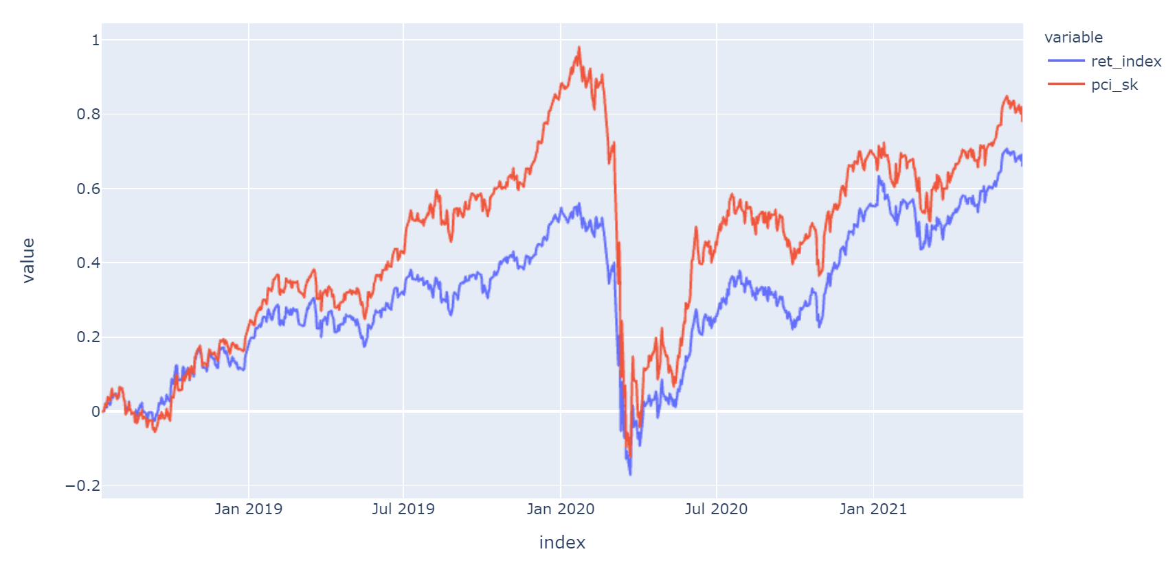
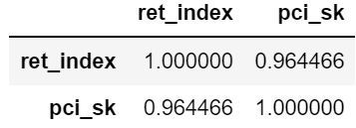
Testing the new index
In this chart, we compare the performance of the official index (Ibov) and the index we’ve just built using the PC1. The proposed index did provide better performance, but more importantly, the correlation against the existing index is extremally high (96.45%), even having a completely different portfolio composition.

Slide 12
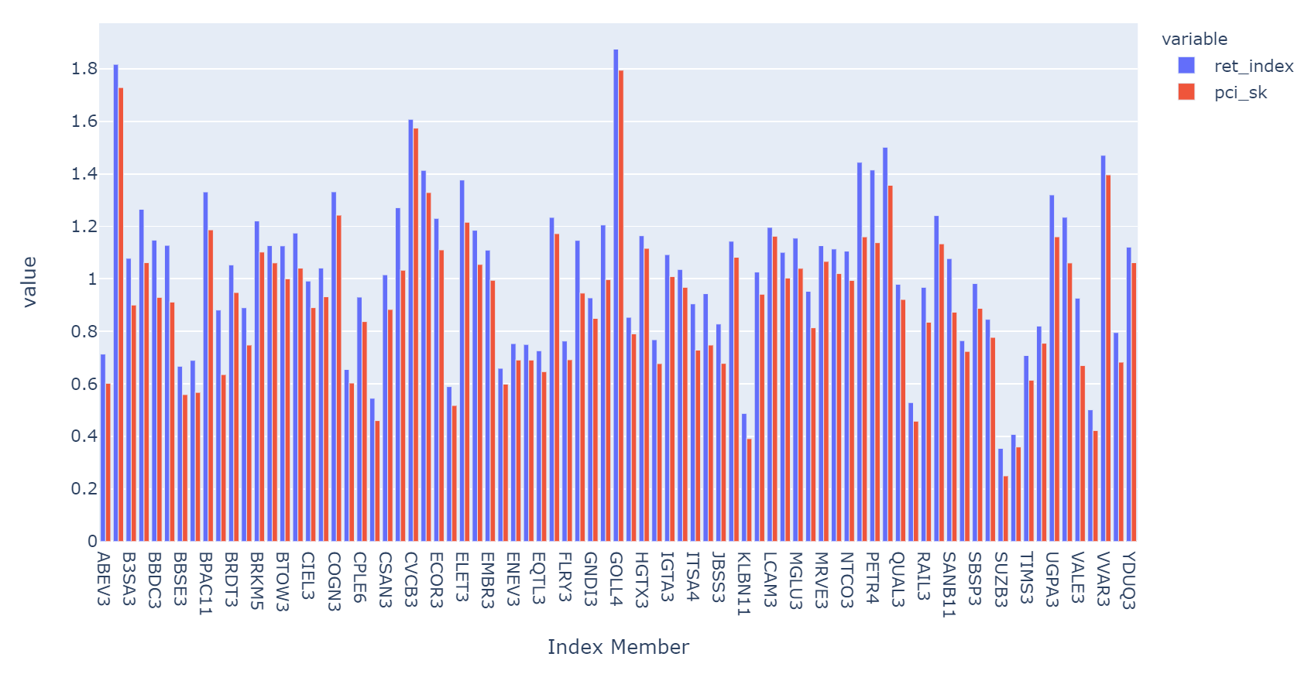
Beta Analysis
In this chart we compare the Beta (sensitivity against the index) of the original Ibov (blue) and the new index (red). We can observe that the Beta of the stocks using PC1 index is consistently lower than using the original one. Lower Beta implies lower sensitivity to the underlying index, therefore lower risk.

Slide 13
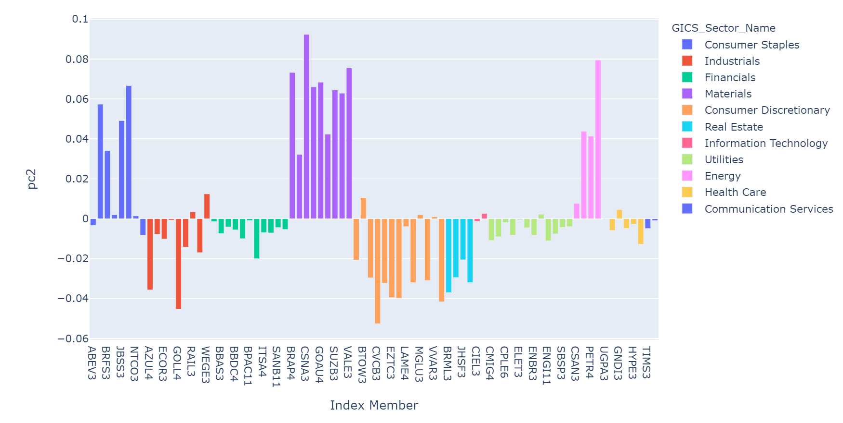
PC2 Composition
Having eliminated directional stock moves through PC1, PC2 shows common patterns within the stocks aside of overall equities sentiment. In this chart, we show the loadings of each stock in PC2, and we set different colors for different stock sectors. As we can see, there’s a clear pattern on how different stock sectors behave, and PC2 represents long positions in Consumer Staples, Materials and Energy, against short positions in Industrials, Financials, Consumer Discretionary, Real State and Utilities. So PC2 works perfectly as a measure of skewness in stock markets.

Slide 14
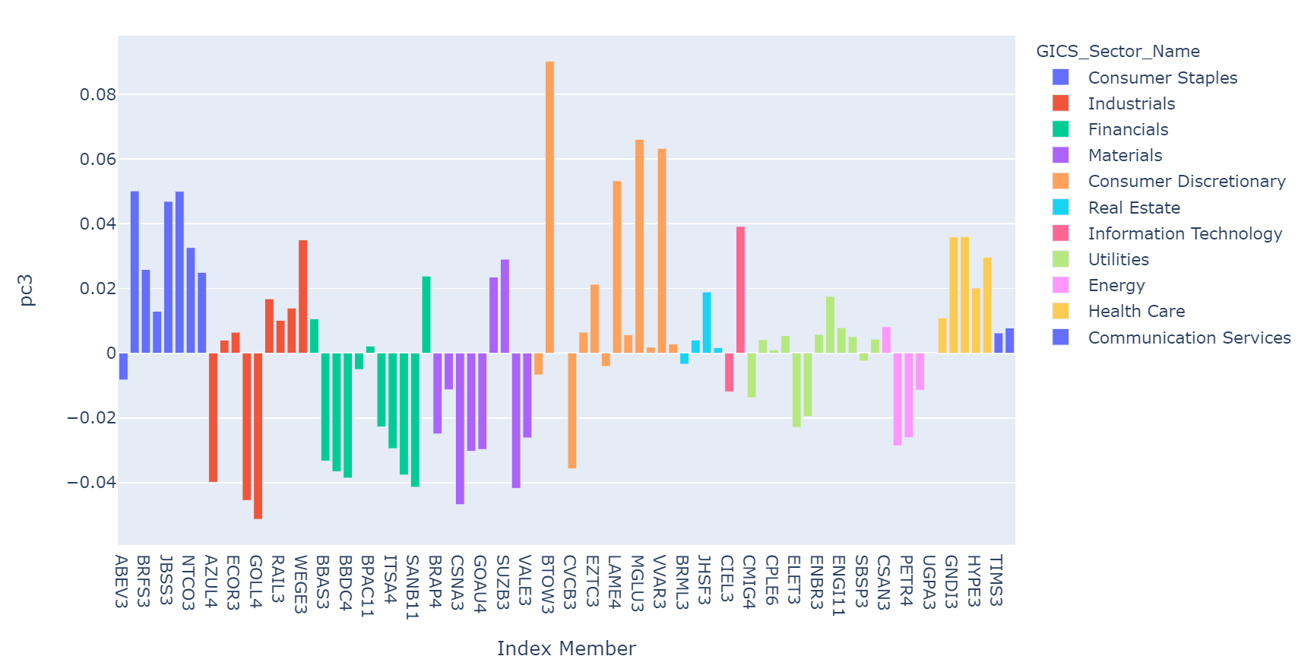
PC3 Composition
Although not as pronounced as PC2, PC3 also shows very good patterns in terms of stock sectors. PC3 loadings show long positions in Consumer Staples, Consumer Discretionary, Real Estate, Information Technology, Health Care and Communication Services, against short positions in Financials, Materials and Energy. Please note that compared to PC2, while Consumer Staples and Financials remain in the same direction, sectors like Materials, Energy, Consumer Discretionary and Real Estate flip sides. So, while PC1 represents a weighted parallel move on stocks, and PC2 the skewness, PC3 brings excellent indication of convexity.

Slide 15

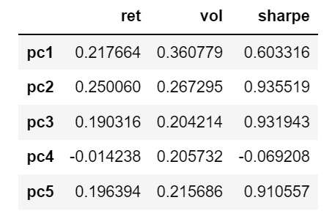
The Power of Breaking the Traditional Index into Uncorrelated Strategies
As mentioned in the beginning of this presentation, what really maters for investors is the return for the risk they run, as risk can always be scaled according to their appetite/tolerance. Return per risk is generally expressed as the Sharpe Ratio. If an investor had purely ran equities risk through the index, he would have obtained a 0.62 Sharpe in this period. But if we break their exposure through the 3 main principal components as different strategies, being the first one Beta weighted parallel shift (PC1), Skew (PC2) and Convexity (PC3), the Sharpe increases to 1.33. If we add more PC’s (like 5), it keeps increasing to 1.46, even having negative return in PC4. But as mentioned before, since it is hard to interpret the PC’s beyond 3, we will refrain to the first 3 ones.
Ibov Index
3 PC’s Portfolio
PC’s Indexes
5 PC’s Portfolio

Slide 16
Conclusion
As presented in this project, the index built through the PC1 is more efficient for portfolio construction than using the original index, since:
It eliminates the problem of having high weigh concentrations in the index because of market capitalization;
It provides much better portfolio diversification and less idiosyncratic risk;
It has a very high correlation with original index, even having a totally different portfolio composition;
Stock returns have lower sensitivity to the new index despite of the high correlation, meaning that it provides lower risk.
The downside of using such an index in risk management is that we cannot trade this index in the market, just like futures on stock index. However, we can still use the existing index as instrument, and use its Beta against the PC1 index, decomposing its risk according the weights of the new index.
Although this presentation was more focused on the PC1, the same way it explains Beta weighted parallel move of the stock markets, PC2 provides excellent explanation of skewness, while PC3 brings represents how the skew changes, bringing convexity to the profile. Other PC’s also have reasonable explanation power, but beyond this level interpretation becomes very challenging, so they are not part of the analysis.
The fact that there’s no official index following this principle, shows that financial markets still have a long way to go using machine learning to get alternative ways of risk management.

